Slide 1
OBJECT ORIENTED PROGRAMMING

Slide 2

Learning Objectives for OOPS
Encapsulation
Inheritance (IS-A Relationship)
Polymorphism
Method Signature
Overloading
Overriding
this or super
Final & static
Abstract class
Interface

Slide 3
Encapsulation
Encapsulation in Java is a mechanism of wrapping the data (variables) and code acting on the data (methods) together as a single unit. In encapsulation, the variables of a class will be hidden from other classes, and can be accessed only through the methods of their current class. Therefore, it is also known as data hiding.
To achieve encapsulation in Java −
1. Declare the variables of a class as private.
2. Provide public setter and getter methods to modify and view the
variables values.

Slide 4
Encapsulation contd.
Benefits of Encapsulation
1. The fields of a class can be made read-only or write-only.
2. A class can have total control over what is stored in its fields.
3. The users of a class do not know how the class stores its data. A class can
change the data type of a field and users of the class do not need to
change any of their code.

Slide 5
Polymorphism
Polymorphism in java is a concept by which we can perform a single action by different ways. Polymorphism is derived from 2 Greek words: poly and morphs. The word "poly" means many and "morphs" means forms. So polymorphism means many forms.
There are two types of polymorphism in java
Compile time polymorphism [Method Overloading]
Runtime polymorphism. [Method Overriding]

Slide 6
Method Overloading[CompileTime PloyMorp]
If a class has multiple methods having same name but different in parameters, it is known as Method Overloading.
There are two ways to overload the method in java
By changing number of arguments
By changing the data type

Slide 7
Method Overriding
Ability to define a behavior that's specific to the subclass type, which means a subclass can implement a parent class method based on its requirement.
Usage of Java Method Overriding
Method overriding is used to provide specific implementation of a method that is already provided by its super class.
Method overriding is used for runtime polymorphism

Slide 8
Method Overriding
Rules of Method Overriding
Method name should be exactly same from Parent to Child.
Return type should be same or Co-Varient.
While overriding don’t decrease the visibility scope of the method.
While overriding the child can throw a unchecked exception.
While overriding the child can’t throw the broader exception. It should be either same or Co-Varient of it.

Slide 9
Method Signature
Here is an example of a typical method declaration
public double calculateAnswer(double wingSpan, int numberOfEngines) throws NumberFormatException {
//do the calculation here
}
Syntax
<<Access_Modifier>> return_type name of function (parameter list) <<Exception List>>{ //body
}

Slide 10
Method Signature Contd.
Method declarations have six components, in order:
Modifiers—such as public, private
The return type—the data type of the value returned by the method, or void if the method does not return a value.
The method name—the rules for field names apply to method names
The parameter list in parenthesis—a comma-delimited list of input parameters, preceded by their data types, enclosed by parentheses, (). If there are no parameters, you must use empty parentheses.
An exception list
The method body, enclosed between braces—the method's code, including the declaration of local variables, goes here.

Slide 11
Super and this Keyword
this is a reference to the object typed as the current class, and super is a reference to the object typed as its parent class.
In the constructor, this() calls a constructor defined in the current class. super() calls a constructor defined in the parent class.
Calling this.method() calls a method defined in the current class where super.method() will call the same method as defined in the parent class.

Slide 12
Final Keyword
Final keyword is used in several different contexts
A final class cannot be sub classed. This is done for reasons of security and efficiency. Accordingly, many of the Java standard library classes are final, for example java.lang.System and java.lang.String. All methods in a final class are implicitly final
A final method can't be overridden by subclasses.
A final variable can only be initialized once, either via an initializer or an assignment statement (Used as declaring CONSTANT)

Slide 13
Static Keyword
Static keyword can be used in 3 scenarios
static variables
It is a variable which belongs to the class and not to object(instance)
Static variables are initialized only once , at the start of the execution
A single copy to be shared by all instances of the class
A static variable can be accessed directly by the class name and doesn’t need any object
Syntax : Class.variable
static methods
It is a method which belongs to the class and not to the object(instance)
A static method can access only static data. It can not access non-static data (instance variables) unless it has/creates an instance of the class.

Slide 14
Static Keyword Contd.
A static method can call only other static methods and can not call a non-static method from it unless it has creates an instance of the class.
A static method can be accessed directly by the class name and doesn’t need any object
Syntax : Class.methodName()
A static method cannot refer to this or super keywords in anyway
static blocks of code
A special block, called static block which can be used for static initializations of a class
code inside static block is executed only once
It will execute if Object of class is created at the first time
Or It will called you access a static member of that class

Slide 15
Abstract Class
A class that is declared with abstract keyword, is known as abstract class in java.
It can have abstract and non-abstract methods (method with body).
It cannot be instantiated.
There are two ways to achieve abstraction in java
Abstract class (0 to 100%)
Interface (100%)

Slide 16
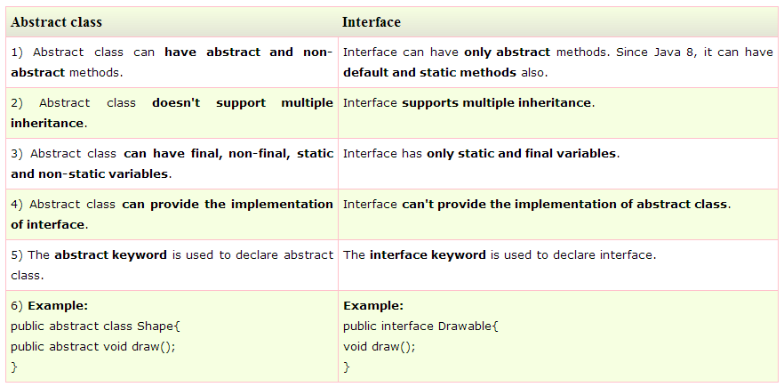
Interface
Java Interface also represents IS-A relationship.
It can be used to achieve loose coupling.
By interface, we can support the functionality of multiple inheritance.

Slide 17
What are we learning in Next Chapter ?
Introduction
Exception Hierarchy
Difference between Exception & Error
Exception handling using : try-catch-finally
Checked and Unchecked exceptions
Multiple catch blocks.
Nested try blocks
User defined exceptions (Customized Exceptions)
Throw and Throws

Slide 18
Thank You !

